Slide 1

DWARKADAS VITHALDAS DARBAR MEMORIAL TRUST’S
SMT KUMUDBEN DARBAR COLLEGE OF COMMERCRE, SCIENCE & MANAGEMENT STUDIES
PROJECT ON
“ BLOOD BANK MANAGEMENT SYSTEM ”
SUBMITTED BY
Mr. Chetan Angadi
Mr. SAYYEDIFROZ INAMDAR
Mr. Shubham Mutagikar
Project Guide Co-ordinator Principal
Smt. Rajeshwari Pathak Smt. Rajeshwari Pathak Shri.V.B.Grampurohit

Slide 2
INTRODUCTION The main objective of the blood bank management system is to manage the details of Blood, Donor, Blood Group, Blood Bank, Stock. Blood Bank Management System (BBMS) is a browser-based system that is designed to store, process, retrieve and analyse information concerned with the administrative and inventory management within a blood bank. IT aims TO MAINTAIN information OF blood donors, different blood group available in each blood bank and help them manage in better way. IT proVideS transparency in this field, make the process of obtaining blood from a blood bank hassle free and corruption free .

Slide 3
Process This system has been developed on the following This system has been developed on the following hardware configuration :
Process : i5 processer
RAM : 8 Gb
HDD : 1 Tb
This system has been developed on the following software configuration :
Opearting system : win 10
Front end : visual studio 2019
Back end : sql server 2019

Slide 4
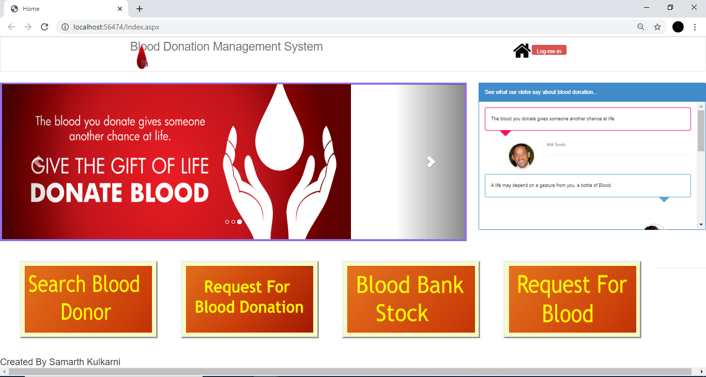
HOME page DESIGN

Slide 5
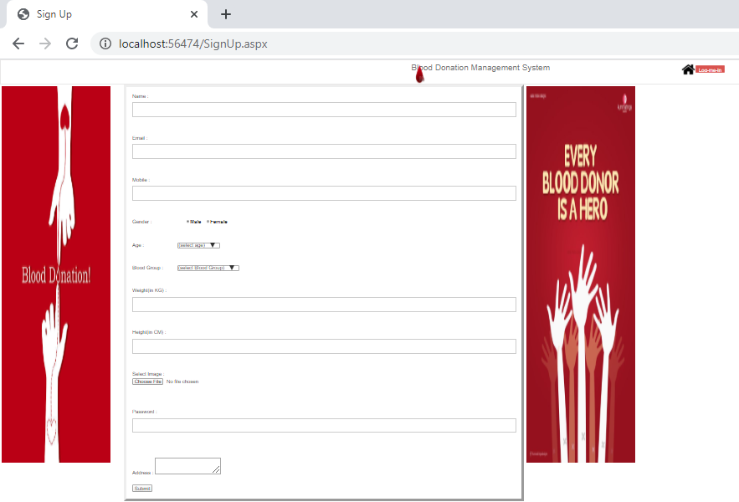
REGISTRATION PAGE

Slide 6
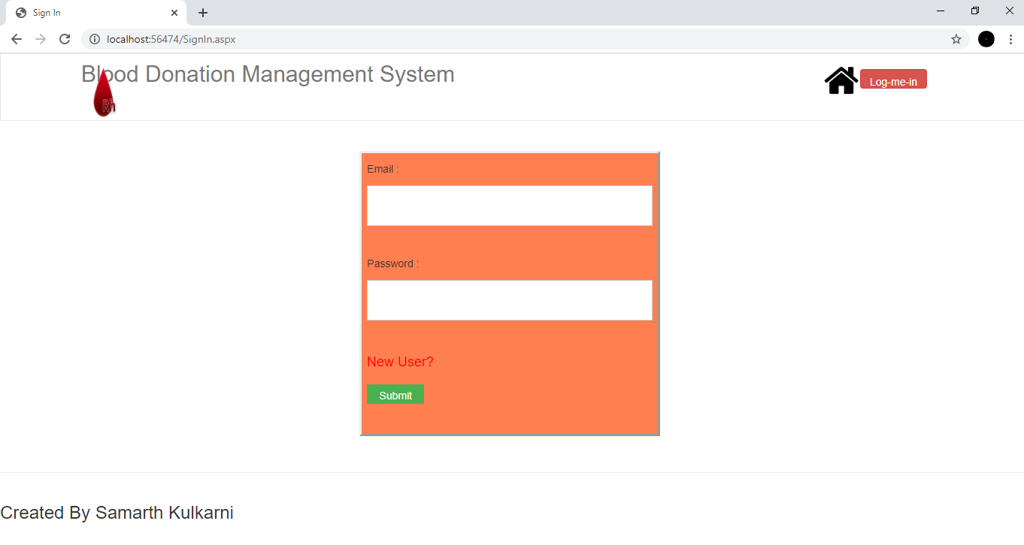
LOGIN PAGE

Slide 7
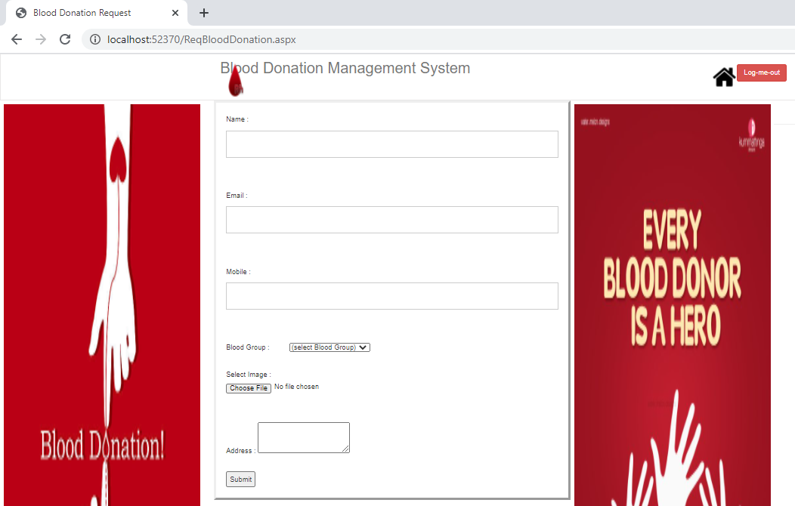
Blood donor registration PAGE

Slide 8
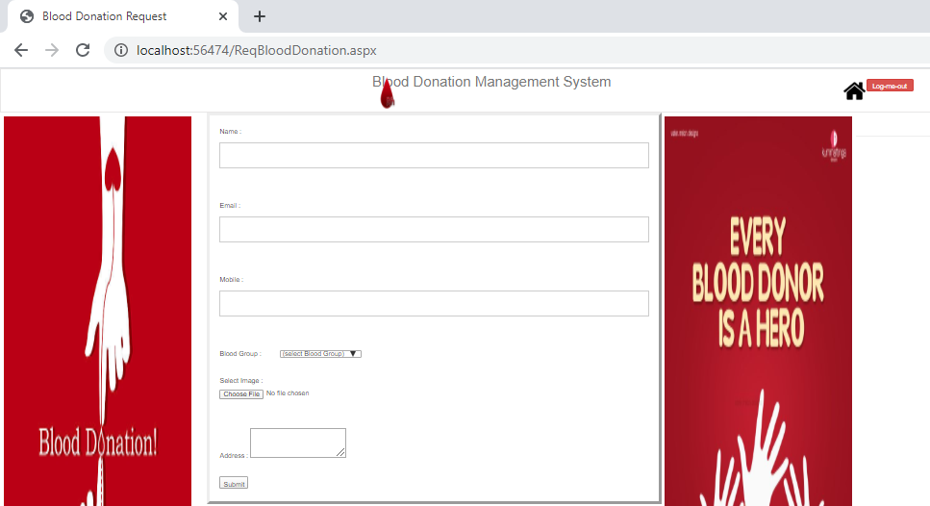
Blood Request PAGE

Slide 9
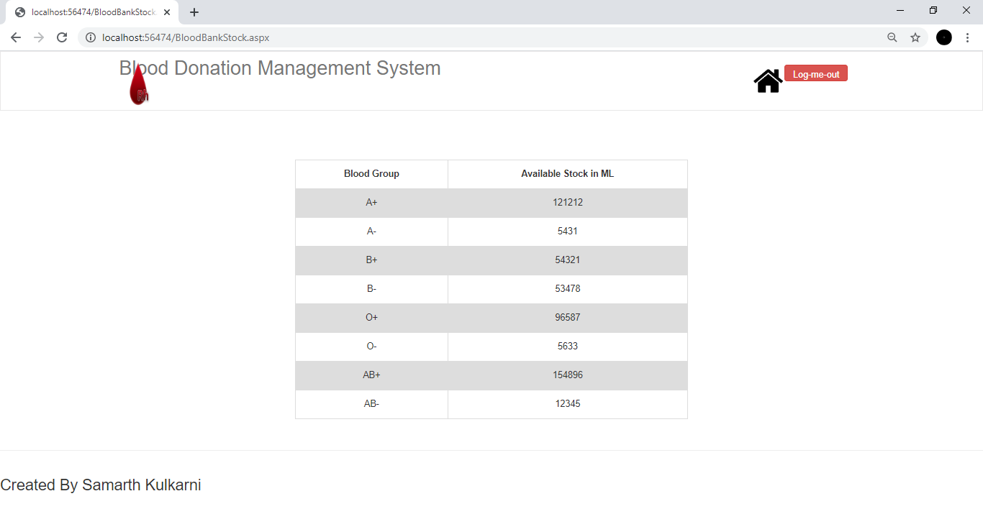
Blood Stock PAGE

Slide 10
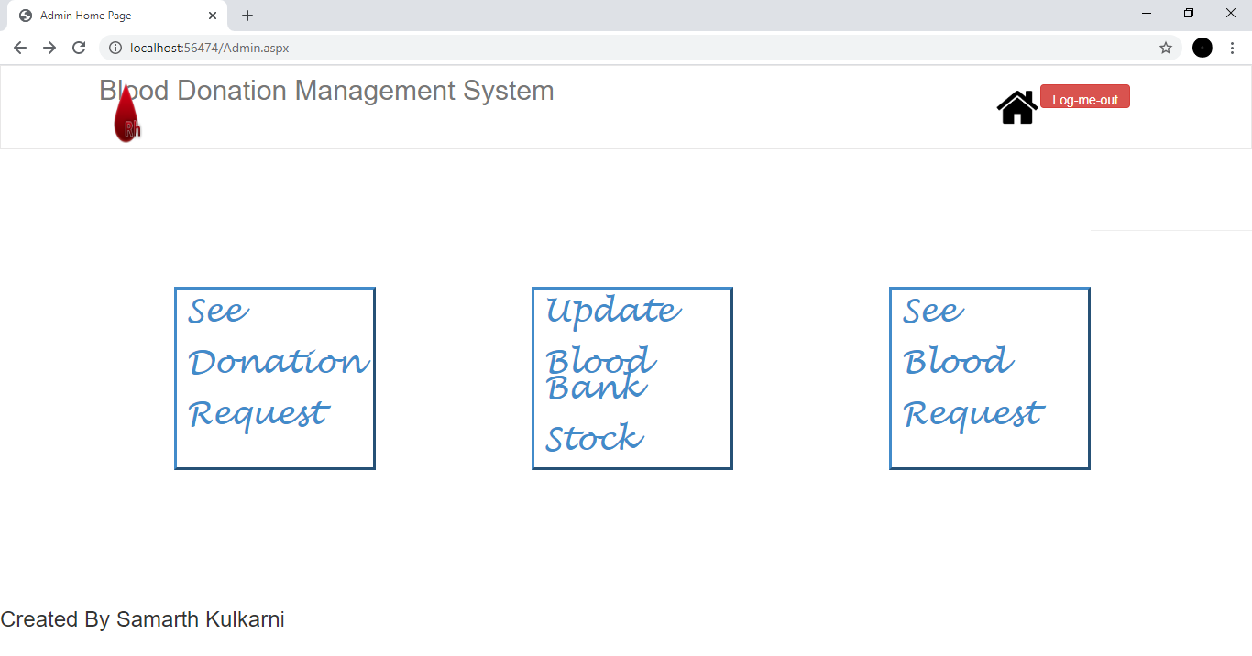
Admin PAGE

Slide 11
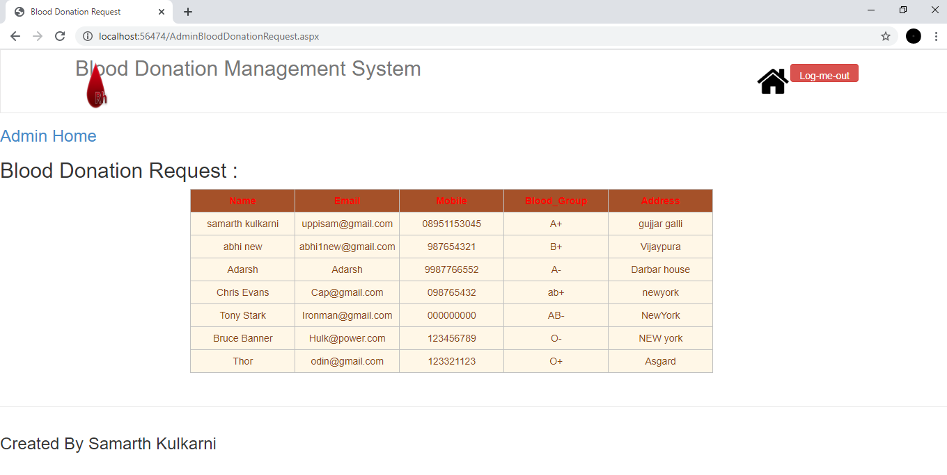
Donation request PAGE

Slide 12
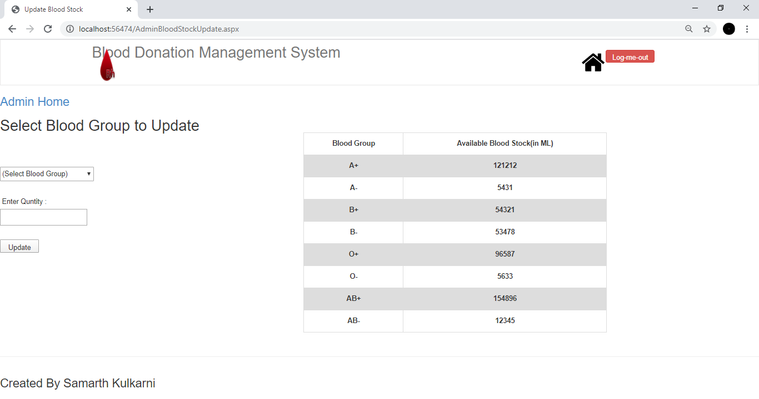
Blood stock PAGE

Slide 13
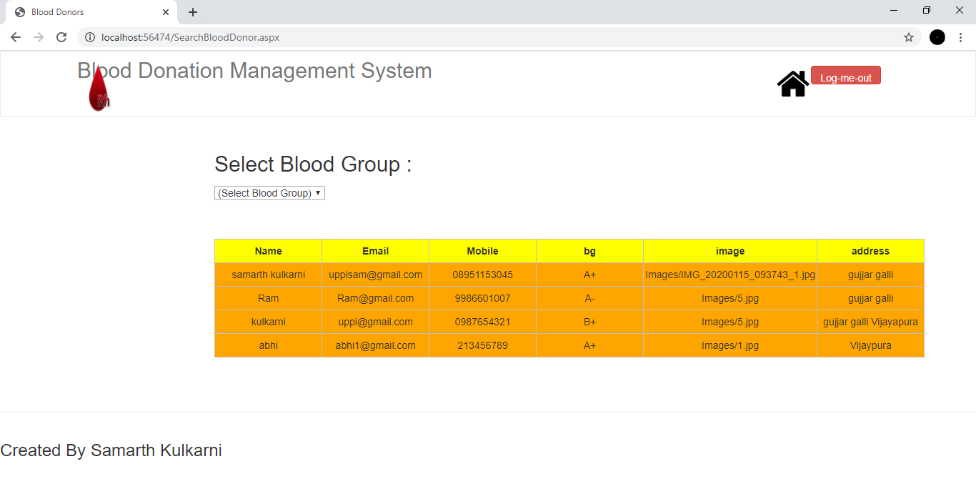
Blood donor search PAGE

Slide 14
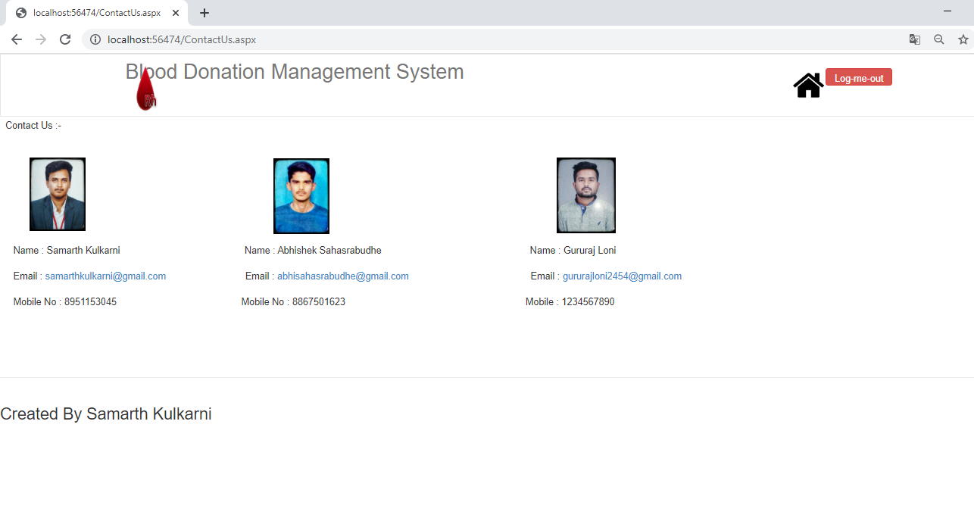
Contact us PAGE

Slide 15
ADVANTAGES
AVAILABILITY OF BLOOD AND STOCK INFO WE GET
DONOR INFORMATION IS EASILY AVAILABLE.
DETAILS OF BLOOD BANKS WE CAN GET EASILY
24/7 ANY WHERE ANYTIME WE GET ALL INFORMATION REGARDING
DONORS AND STOCK OF BLOOD.
IT AIMS TO SAVE THE PATIENT BY GETTING IN TIME BLOOD

Slide 16
Features of the system
Donar management – donar registration, managing donar
database, recording their physical and medical statistics.
inventory management in blood bank for storage
blood requisition and issuance of blood

Slide 17
conclusion
the scope of our project on “blood bank management system [bbms]” is highlighted by the following aspects.
the project is user friendly and very easy for beginners to understand .
facilities such as retrieving donar information, adding new donar information, deleting and listing have been provided.
can see blood bank stock and update it is very easy.
database management for donar, recipient, supervisor and the general public is provided.
this package makes the entire blood bank control easy.

Slide 18
Reference
5th Edition by Herbert
Published by – Hill Publishing Company Limited.

Slide 19
Thank you

